Slide 1
Virtual VDA
Explained – Can you release the benefit? What you need to consider!

Slide 2
Todays Agenda
VDA: The Virtual Deal
Understanding VDA Variances
VDA Efficiency and Productivity
1st Poll
Technology being Rolled Out at an Alarming Rate
VDA Solution
2nd Poll
Virtual VDA has landed
Benefit to the repairer (costs)
Offers
Q&A

Slide 3
Types of VDA
VDA/Technician/Owner/Manager This is someone that has estimating responsibility, but still works on the tools
Dedicated VDA - no qualifications This is someone that has estimating responsibility, but has no ATA or estimating qualifications - but a fundamental interest in this role
Qualified VDA This is someone that has completed their VDA ATA and Estimating assessment on a industry estimating system such as Audatex or GT Motive or similar
Qualified VDA with additional competent training in technology This is some one that has additional training and certified with a competency based outcome such as ADAS in line with IIR

Slide 4
VDA Productivity and Efficiency!
This exercise is based on a bodyshop of medium size 20,000 sq. 15 productive
Typically a medium sized repairer has 2 VDAs
Repairing roughly 40 cars a week
Equates to 4 estimates a day = 1.75 hrs per estimate
1.75 hrs from cradle to grave penny perfect in an ideal world
Typical challenges to that ideal world
Complaints & rectification – how long?
Negotiate and chase authority
Amend estimates as parts prices differ – how many cases?
Onsite estimate discussing with the customer?
Handovers – vehicle repaired
Job cards – who creates these?
Sick leave & holiday & parental leave – who covers and at what expense?

Slide 5
Poll 1

Slide 6
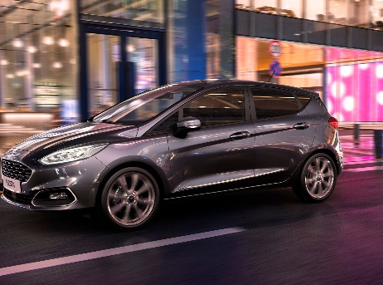
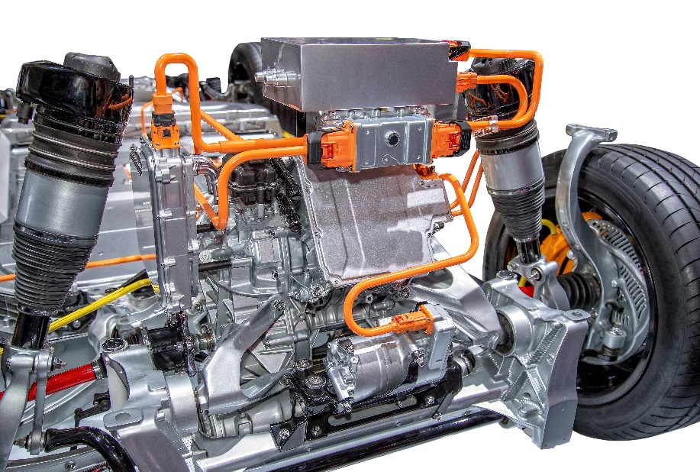
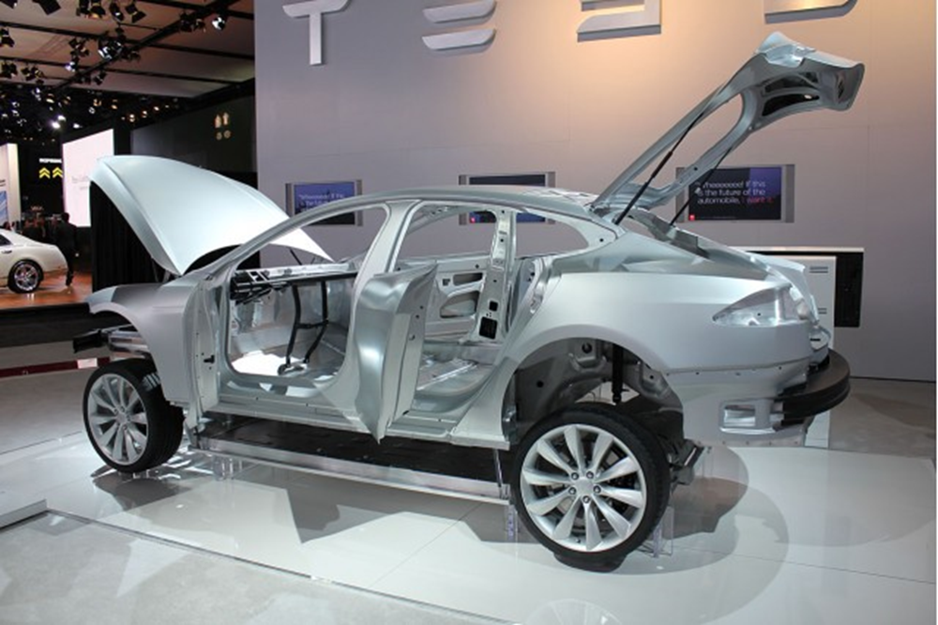
VDA & Technology
With technology evolving at a rapid rate, how can the industry VDA keep up?
Do you allocate dedicated time & budget for your VDA to study the latest vehicles and what tech is being rolled out – such as:
48v, EV, ADAS, Hybrid…
Various substrates – Alloy, Steel HSS, Boron Steel or press hardened steel – what's the difference?
What can be repaired and what needs to be replaced?

Slide 7
VDA Business Solution
What if you could book an online assessment with a 24hr SLA at a fixed cost?
What if you could increase your average hours and P&M?
What if 99% of all your estimates returned would pass through Auda-audit and did not cause cash flow issues by being stuck in pending?
Through Furlough how have you scheduled VDA resource?
Well now you can utilise a digital platform to address any VDA resource issues:
Estimates that are IIR and BSI compliant .
Perhaps you have a surge of work – allow your VDA to work to a high standard and offset the surplus estimate's to VVDA.
Cut down on your estimating software overheads.
Insurer/work provider – Win Win … K2K reduction and a consistent estimating presentation & when you produce a quality estimate and deliver it in a professional and consistent way it builds trust and enables a rapport to be made between fee payer and repairer.

Slide 8
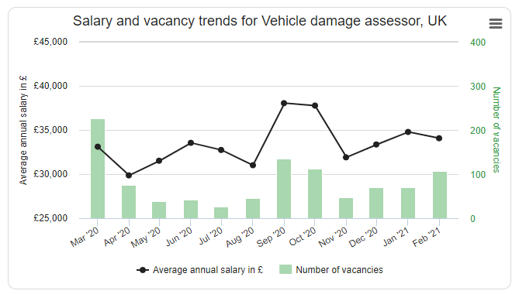
VDA Productivity and Efficiency!

Slide 9
Poll 2

Slide 10
Introducing NBRA – IntelAuto – CrashAssessor UK Solution

Slide 11
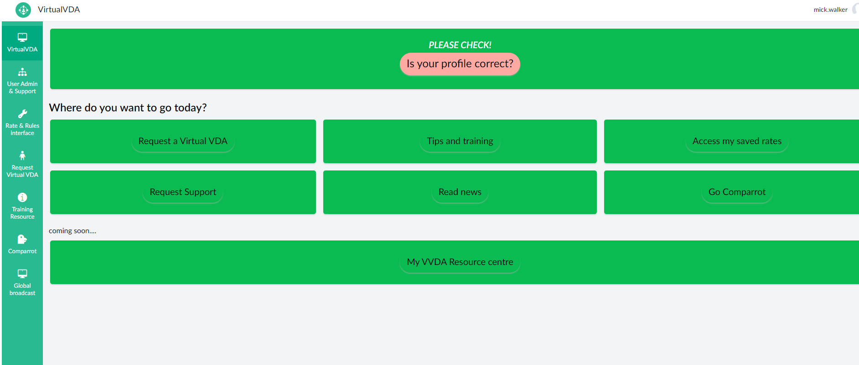
How will Virtual Estimating work? - VVDA

Slide 12
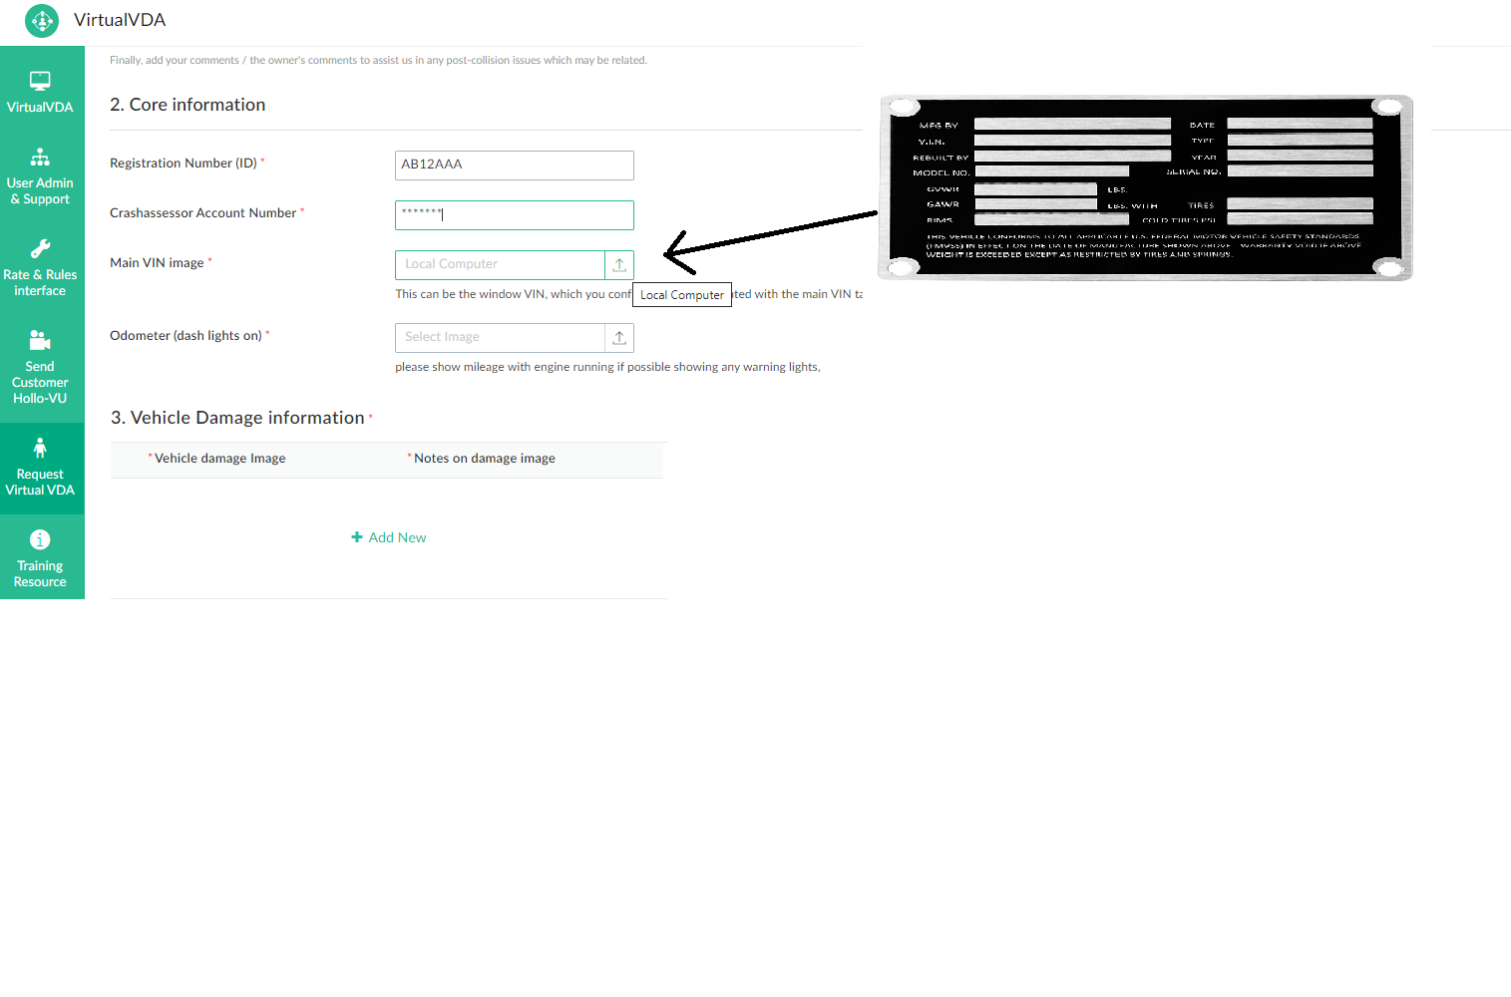
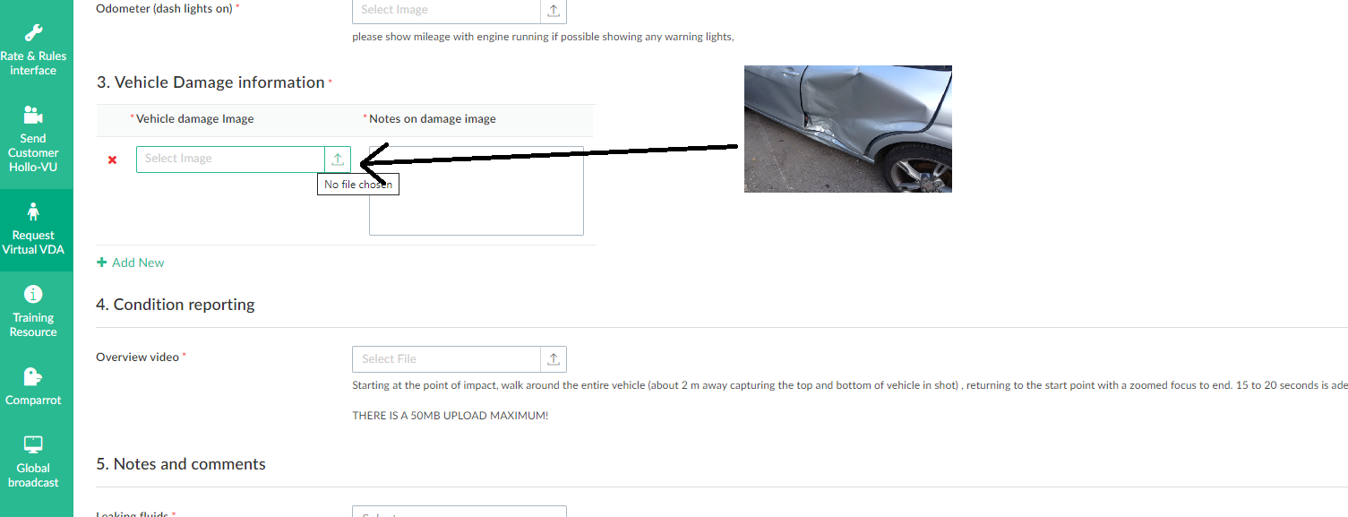

Slide 13
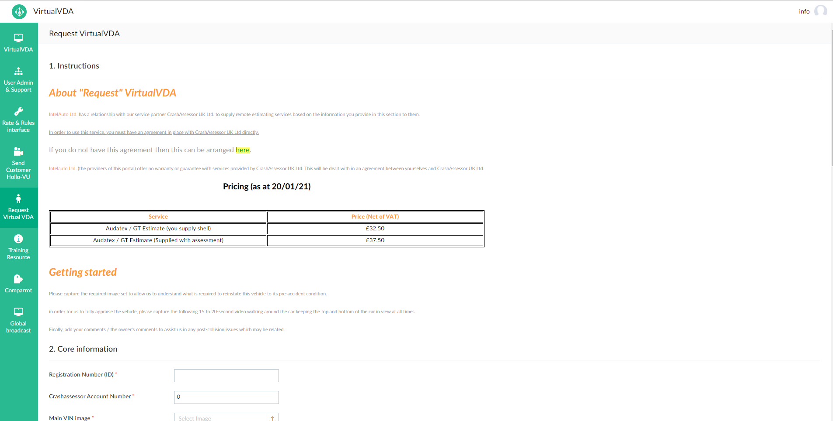
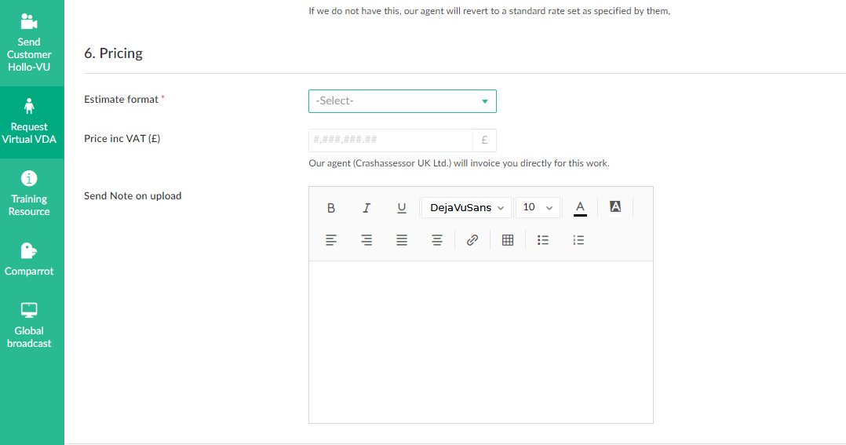

Slide 14
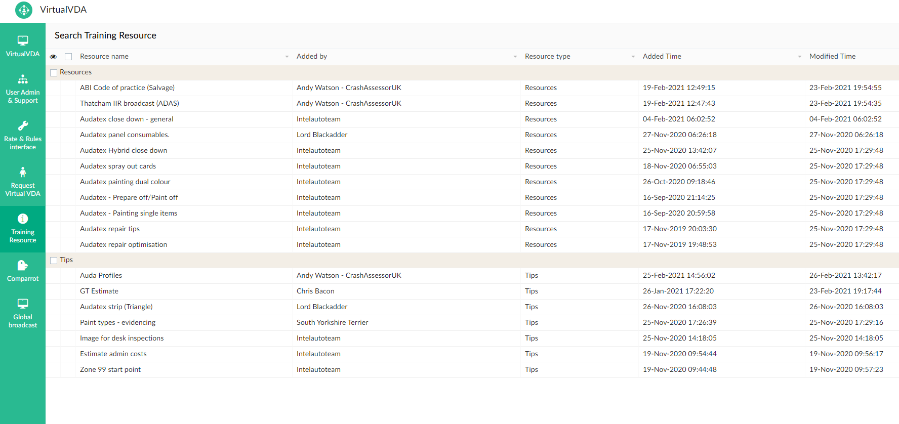

Slide 15
Business Cost How will this Benefit the Repairer?
This exercise is based on a bodyshop of medium size 20,000 sq. 15 productive
VDA cost per day £200 based on average salary & additional costs
Estimate cost £50 on average - be it good, bad or indifferent
Allow your VDA to concentrate on the quality and accuracy of their estimating on complex jobs
Allow your VDA the training they deserve in what is a very confused technical market
Cost of subletting an estimate £32.50 or £37.50 inclusive Auda Shell
Average initial increase in hours approx. 3hrs = £84 based on £28 per hour
Non Audatex users will gain approx. £80 P&M increase
Reduction in CC costs as the K2K will reduce
No delay in estimating - 24hr SLA but on average estimates returned within 8 hrs
Potential for £164 estimate increase that is compliant & method driven - that’s almost 10% of the average national repair cost!
VDAs can utilise the NBRA Technical Page – IntelAuto.co.uk & Crash Assessor UK Hints & Tips will enable your VDA to upskill and utilise the pool of knowledge at their finder tips, it will also create the VDA forum that this industry desperately needs.

Slide 16
VVDA Offer
2 week trial offer 50% discount unlimited volume = £16.25 or 18.75 per estimate .
NBRA will give away a bottle of champagne to the first 3 repairers to reach 25 estimates.

Slide 17
Questions
www.nbra.org.uk/technical

Slide 18
Thank You!

